Slide 1
COMPARING REGRESSION TECHNIQUES FOR STOCK PRICE PREDICTION
Group 4
Sitanshu Rupani | Ronak Sankaranarayanan

Slide 2
Introduction

Slide 3
THE AGE OF APP BASED INVESTING
Financial Services companies are rushing in headlong to develop mobile applications for investing in Stocks, ETFs and Options

Slide 4
RISE OF THE PLANET OF THE APPS
App Based and Online investing services have seen a meteoric rise since the beginning of 2000
This rise has been underpinned by lowering brokerage and transaction costs Y-o-Y consistently since the 80’s

Slide 5
Methods Used

Slide 6
LET’S REVIEW THE METHODS USED
Multilinear Regression
Multiple linear regression is a statistical technique that uses several explanatory variables to predict the outcome of a response variable. The goal of multiple linear regression is to model the linear relationship between the explanatory (independent) variables and response (dependent) variable.
Decision Tree Regressor
Decision tree builds regression or classification models in the form of a tree structure. It breaks down a dataset into smaller and smaller subsets while at the same time an associated decision tree is incrementally developed. The final result is a tree with decision nodes and leaf nodes.
Support Vector Regression
Support vector machine (SVM) analysis is a popular machine learning tool for classification and regression. SVM regression is considered a nonparametric technique because it relies on kernel functions. It finds a line or hyperplane that best fits the data points.
Random Forrest Regression
A Random Forest is an ensemble technique capable of performing both regression and classification tasks with the use of multiple decision trees and a technique called Bootstrap Aggregation, commonly known as bagging.
ARIMA Time Series
A time series is a sequence where a metric is recorded over regular time intervals. ARIMA, short for ‘Auto Regressive Integrated Moving Average’ is actually a class of models that ‘explains’ a given time series based on its own past values, that is, its own lags and the lagged forecast errors, so that equation can be used to forecast future values.

Slide 7
PROCESS :
Load Dataset
Split Dataset
Training
Visualization
Evaluation
Prediction

Slide 8
PERFORMANCE
Regression Techniques | MSE | RMSE
Multi Linear Regression | 0.67 | 0.81
Decision Tree Regression | 962.67 | 31.02
Random Forest Regression | 962.44 | 31.07
SVR | 1977.08 | 44.46
ARIMA | 4.86 | 2.02

Slide 9
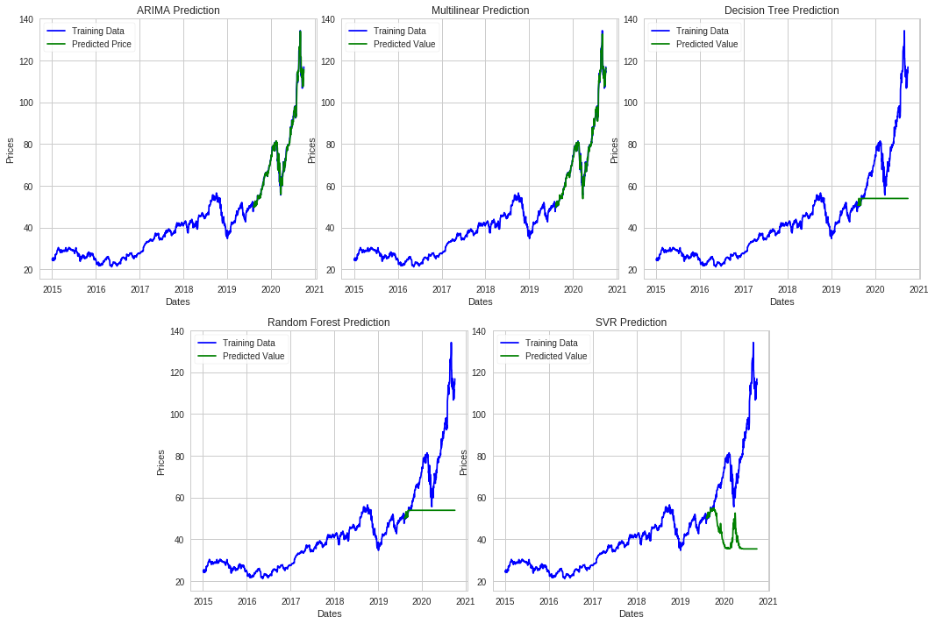
VISUALIZING THE RESULTS

Slide 10
THANK YOU!
Any questions?

